Slide 1
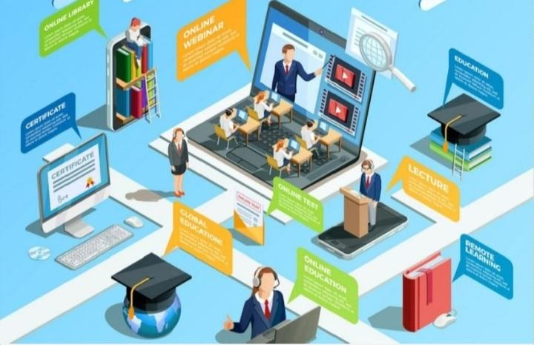
“Affordable Education”
Project created by YoungCrew for Hack4World Baku

Slide 2
“YoungCrew members”
Sabina Aytach Amil Hajıağa
Business plan Presentation Coding Prototype

Slide 3
Problems Sollutions
There may be a number of problems in children’s 1. Children/youth interested in the foreign
educational which reduce their resilience to learing environment have the opportunity to
education, and most importantly their “Affordable watch the lessons of foreign teachers for free.
Education” format. And parents who are usually 2. Activity of children/youh who hide their
closer to their children can solve this problem. It grades from their parents, their price
may be that children are reluctant to tell their statistics are sent to parents by text message
parents about the problem. How can parents be and children are under parential control.
aware of their children’s educational problems? 3. Involve children/youth in education online
But how can we make education accessible to who are unable to study due to illness, family
children with ilness, family problems(what or road problems.
financial problems),traffic problems?

Slide 4
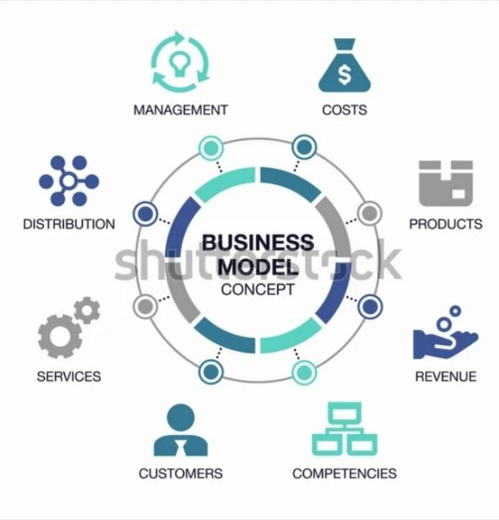
Business model
As a business model of our idea of”Affordable Education” as a team, we can say that education is important for all children, and there are enough uneducated children in the world. The biggest business model is to find solutions to engage children in education.

