Slide 1
Mechathon
Selman Tatli
Nil Derya Tatli
Tatli presents

Slide 2
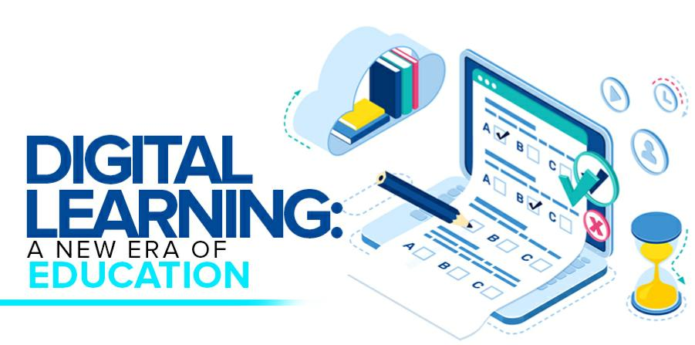
Are you ready for the magnificent future of digital education and entertainment with Mechathon?
Schoology – Tools to support instruction, learning, grading, collaboration and assessment.
We have established our target audience and purpose with the term schollogy introduced by UNESCO.

Slide 3
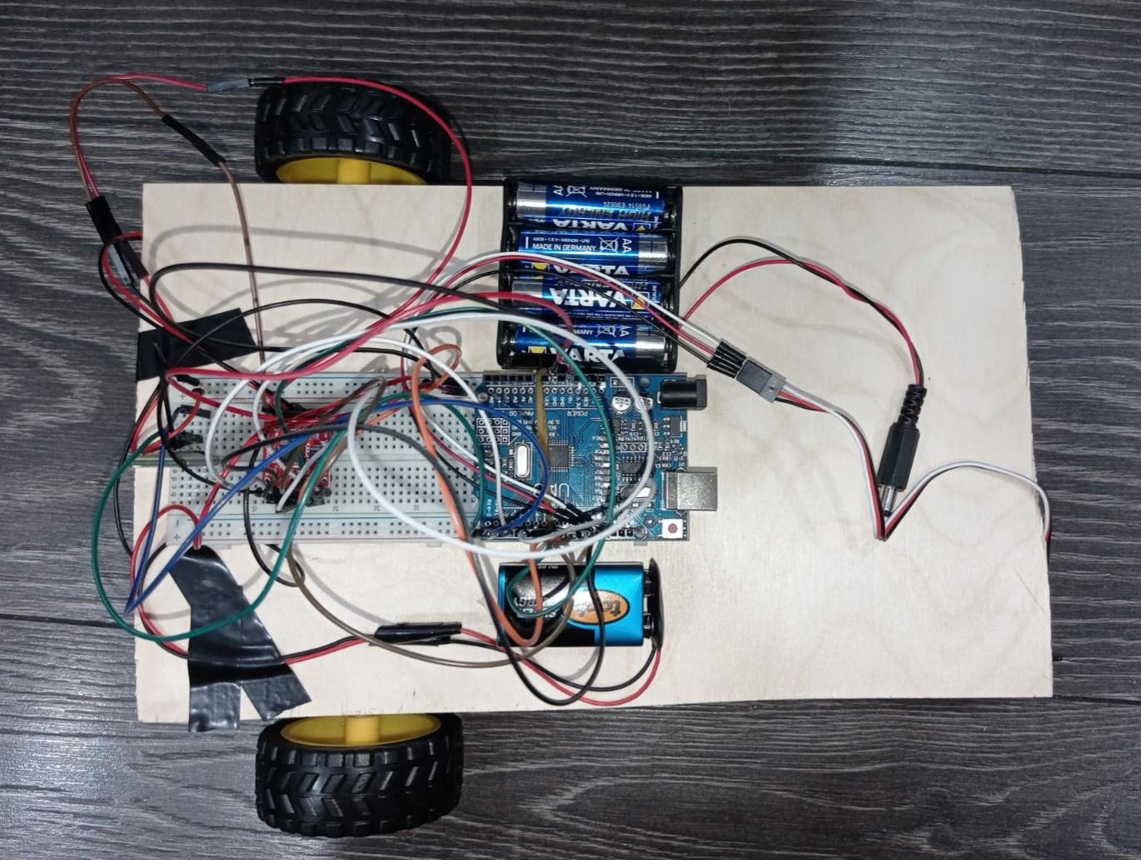
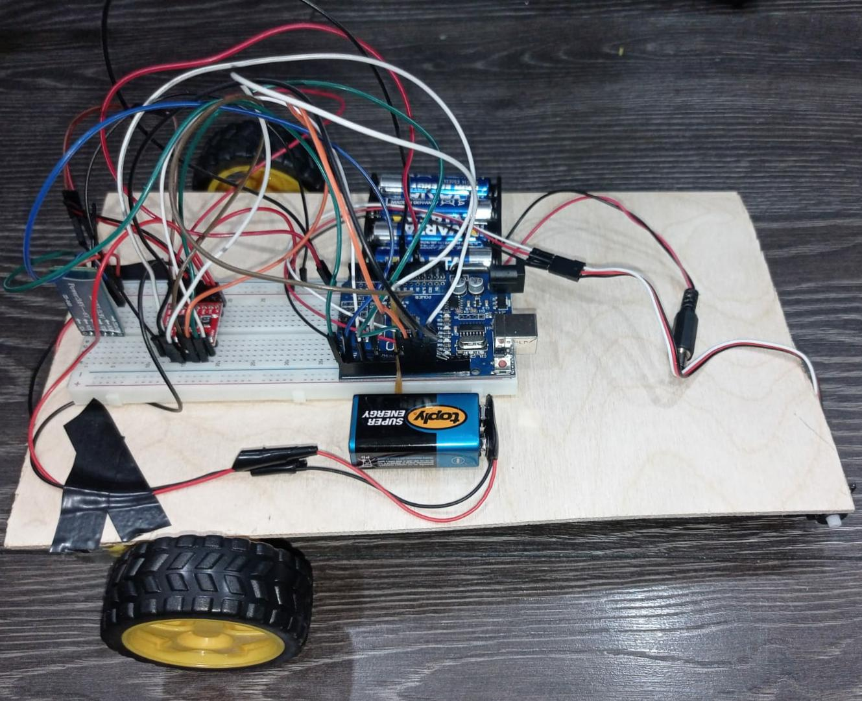
Our mechaton vehicle, which is our project for K-12 education, to introduce and endear the mecha-digital world to students of all ages.

Slide 4
Tools and supplies
1 x 4 AA 1.5V battery bed;
4 1.5V batteries;
1 x 9V battery;
1 Arduino Uno;
2 geared 3-6V motors;
2 wheels;1 rotating wheel;
1 x HC-0-6 blutooth module;
1 x TB6612FNG motor driver;
15 female jumper cables;
20 male jumper cables;
Double-sided tape, insulating tape, silicone and silicone gun, wooden body

Slide 5
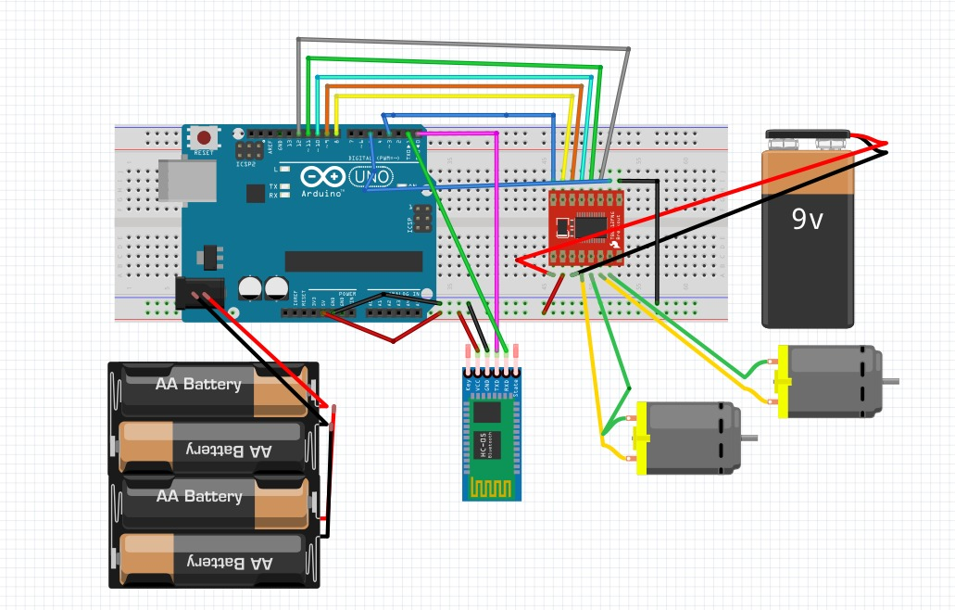
Mechathon as schema;

Slide 6
The codes
#include <Servo.h>
Servo kol;
Int pwma = 3;
int pwmb = 5;
int ain1 = 8;
int ain2 = 9;
int stby = 10;
int bin1 = 11;
int bin2 = 12;
int veri;
void setup() {
pinMode(pwma, OUTPUT);
pinMode(pwmb, OUTPUT);
pinMode(ain1, OUTPUT);
pinMode(ain2, OUTPUT);
pinMode(bin1, OUTPUT);
pinMode(bin2, OUTPUT);
pinMode(stby, OUTPUT); Serial.begin(9600); kol.attach(13); kol.write(150); analogWrite(pwma, 100); analogWrite(pwmb, 100);}void loop() { digitalWrite(stby, HIGH); if(Serial.available()) { veri = Serial.read(); Serial.println(veri); } else if(veri== 'F') { up(); } else if(veri== 'B') { down(); } else if(veri== 'L') { left(); } else if(veri== 'R') { right(); } else if(veri== 'U') { kol.write(80); } else if(veri== 'u') { kol.write(150); } else if(veri== '0') { analogWrite(pwma, 0); analogWrite(pwmb, 0); } else if(veri== '1') { analogWrite(pwma, 25); analogWrite(pwmb,25); } else if(veri== '2') { analogWrite(pwma, 50); analogWrite(pwmb, 50); } else if(veri== '3') { analogWrite(pwma, 75); analogWrite(pwmb, 75); } else if(veri== '4') { analogWrite(pwma, 100); analogWrite(pwmb, 100); } else if(veri== '5') { analogWrite(pwma, 125); analogWrite(pwmb, 125); } else if(veri== '6') { analogWrite(pwma, 150); analogWrite(pwmb, 150); } else if(veri== '7') { analogWrite(pwma, 175); analogWrite(pwmb, 175); } else if(veri== '8') { analogWrite(pwma, 200); analogWrite(pwmb, 200); } else if(veri== '9') { analogWrite(pwma, 225); analogWrite(pwmb, 225); } else if(veri== 'q') { analogWrite(pwma, 250); analogWrite(pwmb, 250); } else { digitalWrite(ain1, LOW); digitalWrite(ain2, LOW); digitalWrite(bin1, LOW); digitalWrite(bin2, LOW); }}void up(){ digitalWrite(ain1, HIGH); digitalWrite(ain2, LOW); digitalWrite(bin1, HIGH); digitalWrite(bin2, LOW);}void down(){ digitalWrite(ain1, LOW); digitalWrite(ain2, HIGH); digitalWrite(bin1, LOW); digitalWrite(bin2, HIGH);}void left(){ digitalWrite(ain1, LOW); digitalWrite(ain2, HIGH); digitalWrite(bin1, HIGH); digitalWrite(bin2, LOW);}void right(){ digitalWrite(ain1, HIGH); digitalWrite(ain2, LOW); digitalWrite(bin1, LOW); digitalWrite(bin2, HIGH);}

Slide 7
THANKS FOR EVERYTHING HACHATHON2021!

